Slide 1
Autonomous Ammunition Depot Hazard Prediction Network
MINI PROJECT WORK [213ECE2463] | V SEMESTER
Design & Field Deployment Using Edge Anomaly Modeling
Team 1 : Aadhithya (9924005006) Abinash (9924005005)
Priya Dharshini (9924005146)
Nagamanisha (9924005312)

Slide 2
ABSTRACT:
The challenge: Depots rely on manual rounds or fixed-limit alarms, so combined mild drifts go unnoticed.
The solution: An STM32 node (ARM Cortex-M4, 180 MHz) reads temperature, humidity, vibration and smoke, learns normal behavior and flags anomalies locally.
The result: Instant LED + buzzer warning and a live PC dashboard over USB serial (COM7),
refreshed every 1 second, with no cloud or internet dependency.
At a glance: 4 parameters monitored | 1 s dashboard refresh | 0 cloud dependency

Slide 3
PROBLEM STATEMENT & MOTIVATION:
Small shifts in temperature, humidity, vibration or smoke can signal real danger, and they often change together, which a single alarm trigger misses.
Fixed thresholds: trigger too late or give false alarms as normal conditions shift.
Manual checks: gaps between rounds let fast-developing conditions go unnoticed.
Connectivity: cloud-based systems lose intelligence when the network fails.
Cost: industrial equipment is costly; modular boards scale cheaply.
Need: a low-cost, self-reliant system that catches risks early with no constant supervision or internet.

Slide 4
OBJECTIVES & SCOPE:
Build a low-cost STM32 node for autonomous depot monitoring.
Track temperature, humidity, vibration and smoke continuously.
Detect abnormal patterns locally, without fixed thresholds.
Trigger an instant LED + buzzer warning without the cloud.
Stream data to a PC dashboard over the serial (COM) link.
Lay the foundation for a depot-wide network of nodes.
Scope: one prototype node (DHT11, SW-420, MQ) plus a scalable architecture. Field use needs calibrated, certified sensors; dashboard limits are demo values.

Slide 5
PARAMETERS MONITORED:
Parameter | Sensor | Why it matters | Warning sign
Temperature | DHT11 | Heat speeds ageing and chemical degradation of stored materials | Slow drift or sudden rise
Humidity | DHT11 | Moisture causes corrosion and damages packaging | Sustained rise beyond usual band
Vibration | SW-420 | Signals rough handling, impact or unauthorized activity | Repeated or prolonged events
Smoke / Gas | MQ sensor | Earliest sign of overheating or fire, often before heat | Reading above its usual level
Why combinations are harder to catch: each reading may stay under its own limit, yet the pattern as a whole is unusual. A learned baseline flags it earlier.

Slide 6
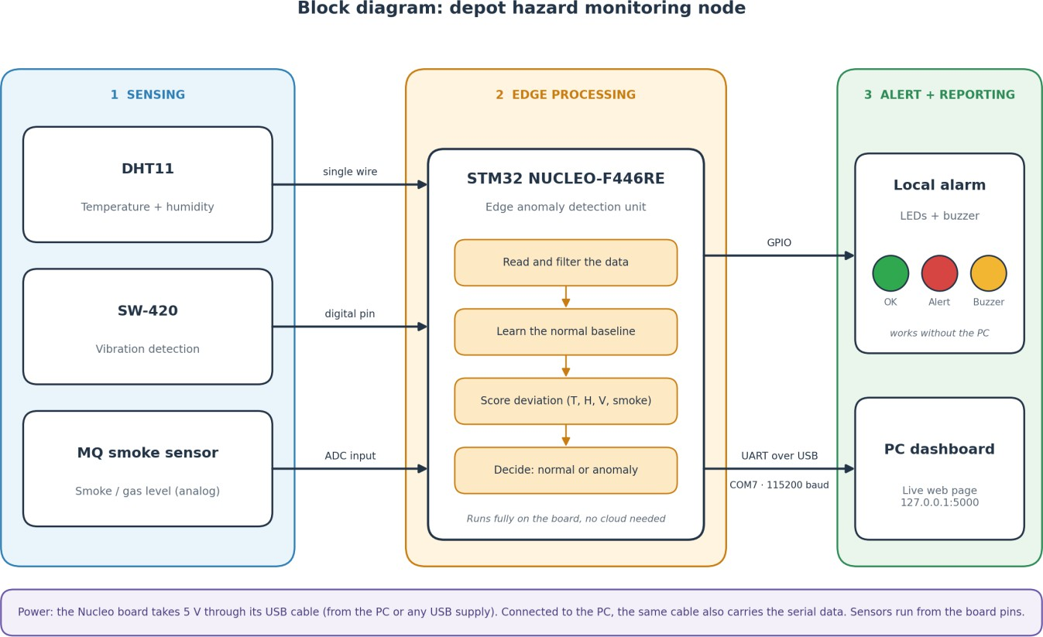
SYSTEM ARCHITECTURE:
Sensing: DHT11, SW-420, MQ sensor
Edge processing: STM32 filters, models, decides
Alert & comms: LEDs, buzzer, UART to PC
Application: live web dashboard on PC
Sense → decide → alarm is separate from reporting, so the alarm never waits for the PC.

Slide 7
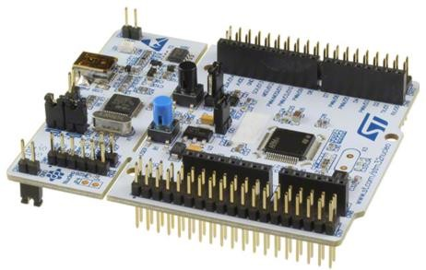
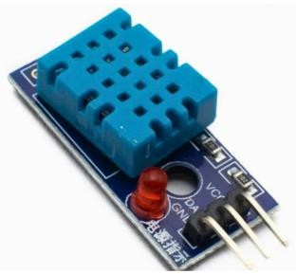
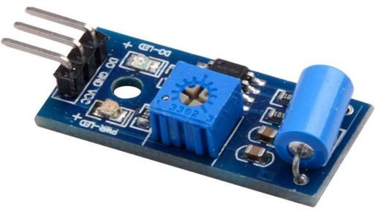
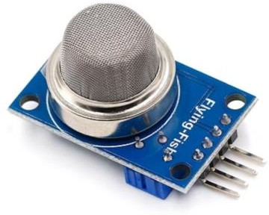
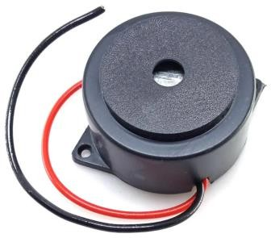
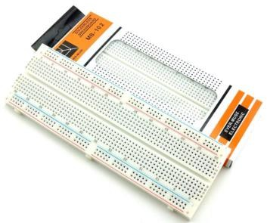
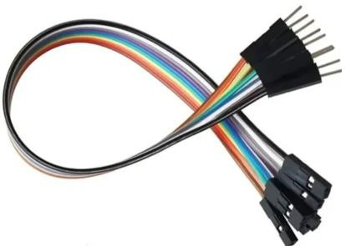
HARDWARE COMPONENTS:
NUCLEO-F446RE
Edge unit, 5 V via USB
DHT11
Temperature & humidity
SW-420
Vibration detection
MQ smoke sensor
Smoke / gas, analog out
Buzzer
Local audible alarm
Breadboard
Circuit connections
Jumper wires
Common-ground wiring
2 LEDs
Green = normal, red = alert

Slide 8
CONNECTIONS & DATA MESSAGE:
Device | STM32 pin | Function
DHT11 data | PA1 | Digital input (1-wire)
SW-420 output | PA4 | Digital input
MQ analog output | PA0 | ADC1_IN0, 12-bit (0-4095)
Green LED | PB0 | Output: normal
Red LED | PB1 | Output: anomaly
Buzzer | PB12 | Output: alarm
UART to PC | PA2 / PA3 | USART2, 115200 baud
UART message (about 1 per second)
T=34.0,H=73.0,V=0,MQ=624,S=OK
T temperature (°C)
H humidity (%)
V vibration activity
MQ raw ADC (624 ≈ 0.50 V)
S state: OK or ALERT
One USB cable gives 5 V power and the serial link (COM7).

Slide 9
EDGE ANOMALY MODELING:
Learn baseline: records the normal level and spread of each feature at start-up.
Score deviation: measures distance from normal in units of normal spread.
Combine scores: weighted sum, so several mild deviations can raise a warning.
Confirm & alert: alert only after several consecutive samples above the level.
Edge preprocessing
Reject invalid sensor reads
Moving average on T, H and MQ
Vibration as event rate in a sliding window
State | Condition | LED | Buzzer
Normal | Score below level | Green | OFF
Anomaly | Above level, confirmed | Red | ON
Recovery | Below release level | Green | OFF

Slide 10
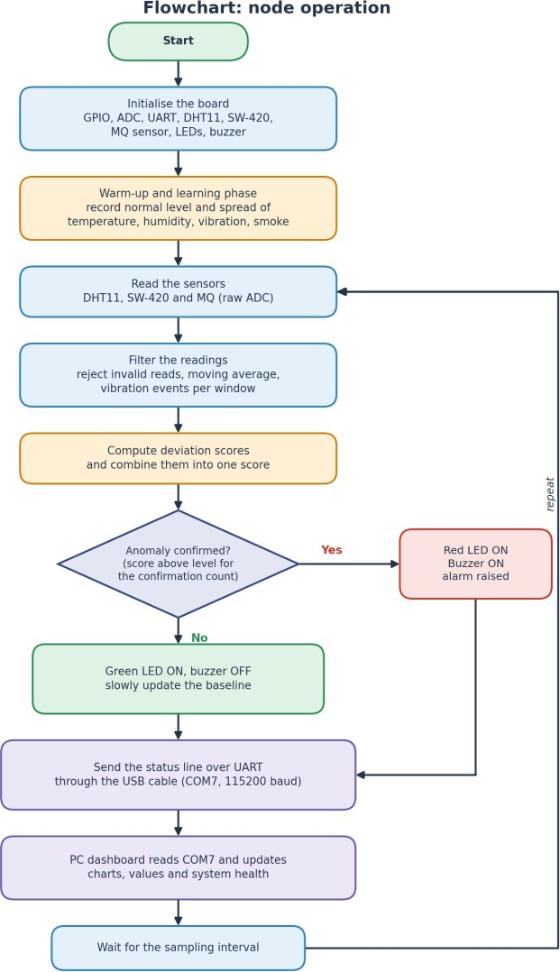
FLOWCHART & ALGORITHM:
Initialize GPIO, ADC, UART and sensors
Warm up MQ sensor; learn the baseline
Read DHT11, SW-420, MQ; reject invalid reads
Moving average; vibration event rate
Deviation score per feature, then combine
Score high for N samples: red LED + buzzer ON, else green
Update the baseline slowly while normal
Send status over UART (COM7, 115200)
Wait for sampling interval; repeat from step 3

Slide 11
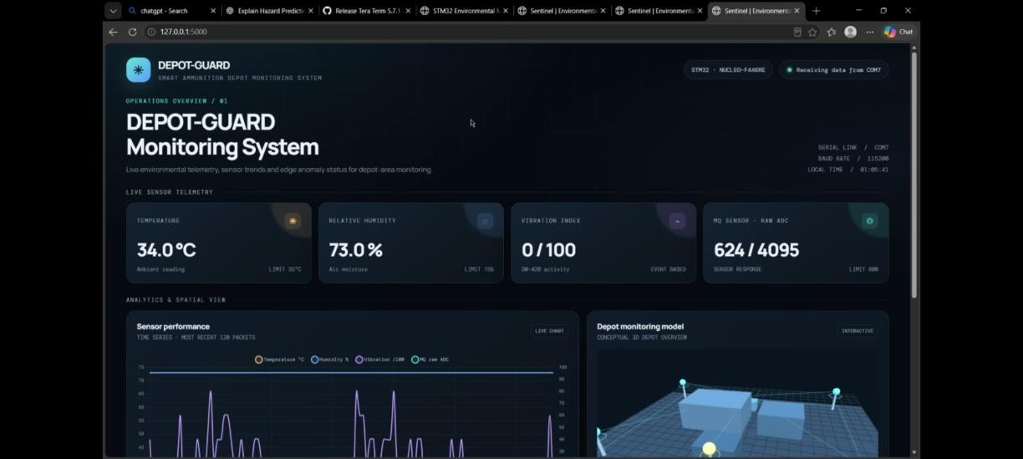
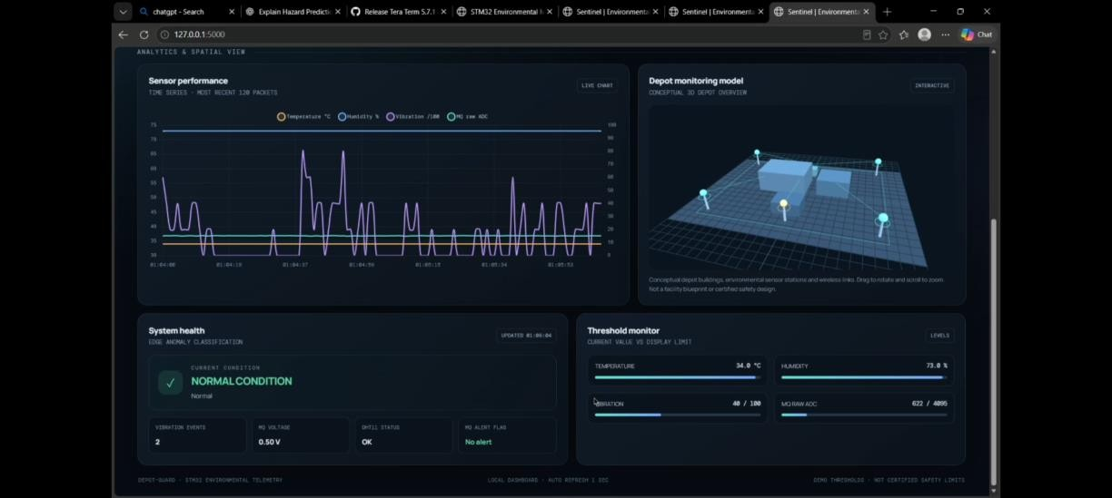
LIVE DASHBOARD (DEPOT-GUARD):
Fig 7.1: Link status and live telemetry cards
Fig 7.2: Sensor chart, depot model, health, thresholds
Live telemetry: temperature, humidity, vibration, MQ.
Sensor chart: latest 120 packets.
System health: anomaly class, MQ flag.
Threshold monitor: values vs display limits.

Slide 12
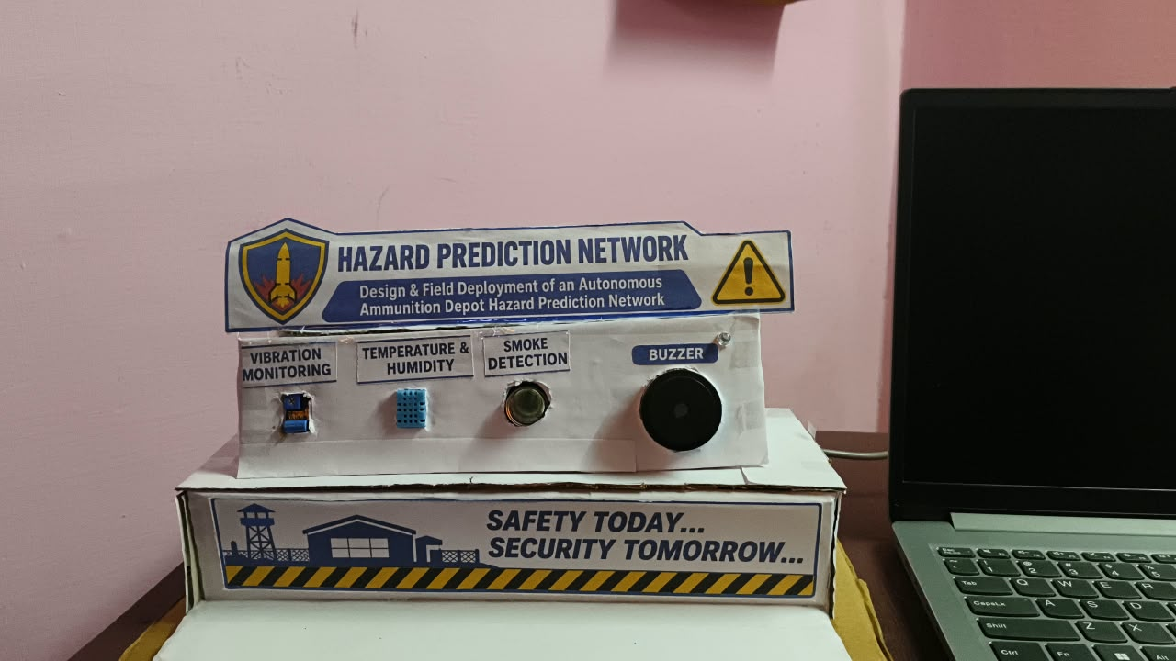
OUTPUT

Slide 13
TEST RESULTS:
Scenario | Node response
Normal condition | Green LED ON, buzzer OFF, dashboard normal
Temperature rise | Deviation grows; alert when sustained
Humidity rise | Deviation grows; alert when sustained
Vibration (tapping) | Event rate rises; red LED + buzzer ON
Smoke near MQ | MQ ADC rises; alarm ON; MQ flag shown
Combined mild changes | Combined score crosses the level
Recovery | Score falls; green LED ON, buzzer OFF
Dashboard stopped | Local alarm continues independently
Live reading | Value
Temperature (limit 35) | 34.0 °C
Humidity (limit 75) | 73.0 %
Vibration (event based) | 0 / 100
MQ raw ADC (≈ 0.50 V) | 624 / 4095
All live readings are within limits.

Slide 14
CONCLUSION & FUTURE SCOPE:
Key Outcomes
Challenges
Future Scope
Continuous monitoring of T, H, vibration and smoke
Anomalies detected locally on the STM32
Instant LED + buzzer warning, no cloud
Live PC dashboard over serial (COM) link
Low-cost, modular and ready to scale
DHT11: limited accuracy, slow refresh
SW-420 digital only; MQ is a relative reading
USB link limits distance to the PC
MEMS accelerometer and accurate sensors
Gas, door and intrusion sensors
On-device TinyML models
Wireless link, solar power, multi-node network
Thank you | Aadhithya, Abinash, Priya Dharshini, Nagamanisha | Guides: Mr. Pavan Kumar E, Mrs. Loyola Jasmine J

